Slide 1




Virtualization vs Containers
The Evolution of Application Deployment
Before Virtualization
Virtualization Era
Container Era
•
1 Application per physical server
•
Multiple VMs on 1 physical host
•
OS-level virtualization
•
Low hardware utilization (10-15%)
•
Hypervisor abstracts hardware
•
Near-instant startup times
•
High infrastructure costs
•
Strict workload isolation
•
Lightweight footprint (MBs vs GBs)
•
Slow & complex scaling
•
Improved resource utilization
•
Unmatched cloud portability
•
Massive resource waste
•
Easier infrastructure management
•
Ideal for modern microservices

Slide 2

Virtual Machines vs Containers
Dimension | Virtual Machines (VMs) | Containers
Abstraction | Virtualize physical hardware | Virtualize host operating system
OS Requirement | Each VM runs a complete Guest OS | Share host OS kernel among instances
Size on Disk | Heavyweight (Gigabytes / GBs) | Lightweight (Megabytes / MBs)
Startup Time | Minutes (Full OS boot sequence) | Seconds or milliseconds
Resource Usage | High CPU/RAM allocation overhead | Minimal overhead, high density
Isolation Level | Strong hardware-level isolation | Process-level isolation (namespaces/cgroups)
Key Takeaway: VMs package an entire operating system along with the app. Containers package only the application code and its explicit dependencies.

Slide 3


Monoliths to Cloud-Native Architecture
Monolithic Architecture
Modern Cloud-Native
Single Codebase & Deployment: Tightly coupled modules compiled together.
Microservices Design: Independent services communicating via APIs (REST/gRPC).
All-or-Nothing Scaling: Must duplicate entire application stack to scale one feature.
Granular Horizontal Scaling: Scale individual components (e.g., Payment vs Search).
Fragile Resilience: A single memory leak or crash can pull down the full system.
Fault Isolation: Failure in recommendations doesn't prevent user logins.
Slow Release Cycles: Risk of regression delays production updates.
CI/CD Friendly: Continuous deployment without customer downtime.
Cloud-Native Core Traits:

Slide 4

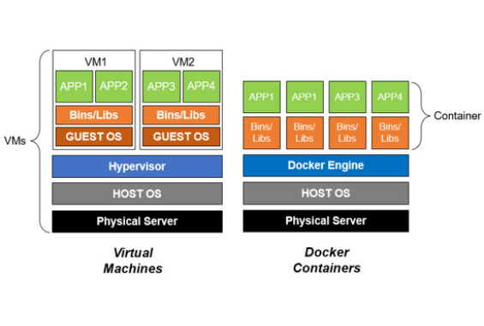

Introduction to Docker
Docker is an open platform that packages applications and all their runtime dependencies into standardized containers.
Key Components
Docker Engine: The core background runtime daemon.
Dockerfile: Text blueprint with step-by-step build instructions.
Docker Image: Read-only package template containing runtime code.
Docker Hub: Centralized public/private container image registry.
TYPICAL WORKFLOW
Write Code Build Image Run Container Deploy Anywhere

Slide 5






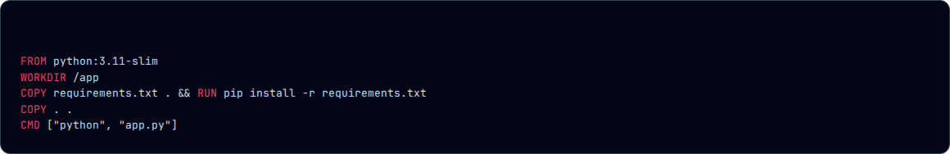
Building Containerized Applications
1. Developer Workflow
2. App Examples
3. Why Containerize?
Create source code, write a Dockerfile defining requirements, compile the image with docker build, run locally, and push to container registries.
Standard microservices like a Python Flask API returning JSON payloads or a lightweight Node.js Express server serving RESTful GET / routes.
Eliminates "works on my machine" bugs. Ensures identical OS libraries, language binaries, and environment dependencies across dev, staging, and production.
Sample Dockerfile

Slide 6




Running Containers Locally
docker pull nginx
docker run -d -p 80:80 nginx
Download specified image template from Docker Hub registry.
Instantiate and execute container detached in background.
docker ps
docker stop
List all currently active and running container processes.
Send SIGTERM signal to gracefully halt executing container.
docker images
docker rm
View all container image blueprints cached on local machine.
Remove stopped container instance from local filesystem.
Core Concept Distinction
Images are read-only blueprints/templates. Containers are isolated, runnable instances created from those templates.

Slide 7





Understanding Container Lifecycle
Image
Created
Running
Stopped
Removed
Read-only Blueprint
Allocated Sandbox
App Executing
Process Halted
Storage Cleaned
Essential Production Concept: Ephemerality
Containers are designed to be ephemeral (short-lived). Orchestrators like Kubernetes or OpenShift destroy and recreate failed containers automatically. Persistent data must always reside in external volumes, databases, or object storage.

Slide 8

Image Sources
https://www.mdpi.com/applsci/applsci-12-06737/article_deploy/html/images/applsci-12-06737-g001-550.jpg
Source: www.mdpi.com

